Slide 1
What are the effects of poverty?

Slide 2
Circle the right answer
1.6 billion/million people in the world live without adequate shelter.
What is meant by ‘adequate shelter’?
Would living in a shack count as ‘adequate shelter’?
That is nearly 1 in 5 people!

Slide 3
Circle the right answer
821 billion/million people in the world do not have enough food.
What happens when people don’t have enough nutritious food?
Where might hungry people be able to get food from?
About 1 in 10 people!

Slide 4
Circle the right answer
785 billion/million people in the world do not have access to clean water.
What is the problem with using dirty water?
About 1 in 10 people!

Slide 5
Circle the right answer
In 2021, men living in the richest/poorest parts of London were expected to live to 84 years old whereas men living in richer/poorer areas such as Blackpool were expected to live to 74 years old.
Why are people living in poverty more likely to get sick?

Slide 6
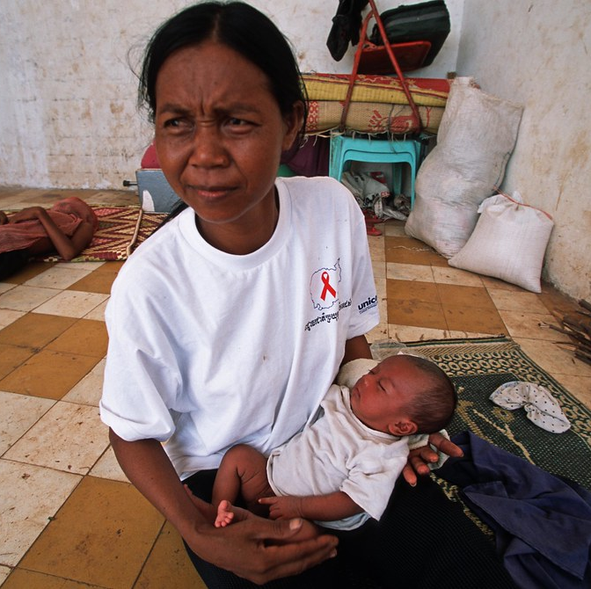
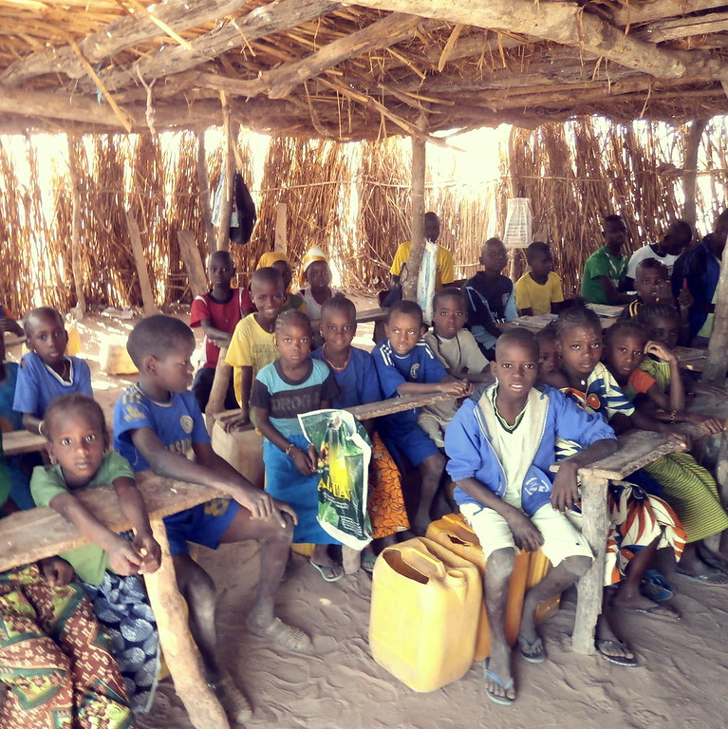
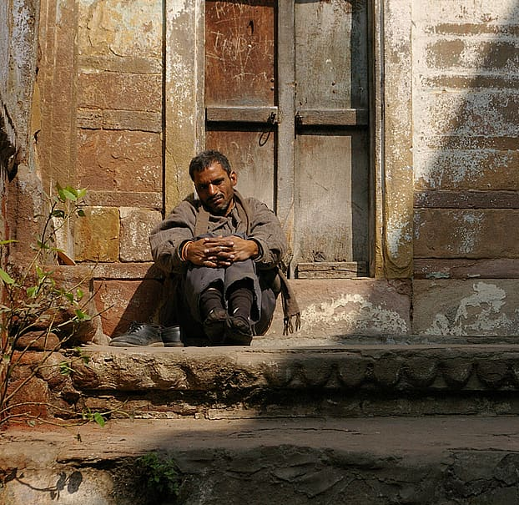
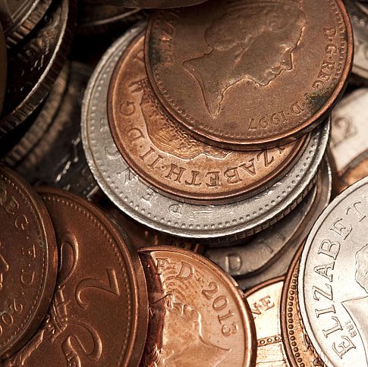
Fill in the blanks
child
They have a _ _ _ _ _ .
poor
Child is born into a _ _ _ _ family.
They are more likely to miss out on quality education because for example:
their parents cannot afford school to pay _ _ _ _ _ _ fees, or buy school uniforms and stationary
they need to stay at home and _ _ _ _ to earn money and support their families instead of going to school
they do not have access to sufficient _ _ _ _ so they are weak and cannot focus in school.
school
work
They are not able to escape the _ _ _ _ _ _ _ cycle because they are stuck in a low-paying job.
food
poverty
jobs
They are stuck in low-paying _ _ _ _ because they don’t have basic skills needed for other jobs.

